Slide 1
Post-Pandemic Cities
Thomas Fisher Professor, School of Architecture
Director, Minnesota Design Center
University of Minnesota, Minneapolis
tfisher@umn.edu

Slide 2


Slide 3
Pandemics:
Accelerate us into the future and magnify trends
Reveal inequities and dysfunctions in existing systems
Bring renewed attention to public & personal health
Create opportunities for those who grasp the change

Slide 4
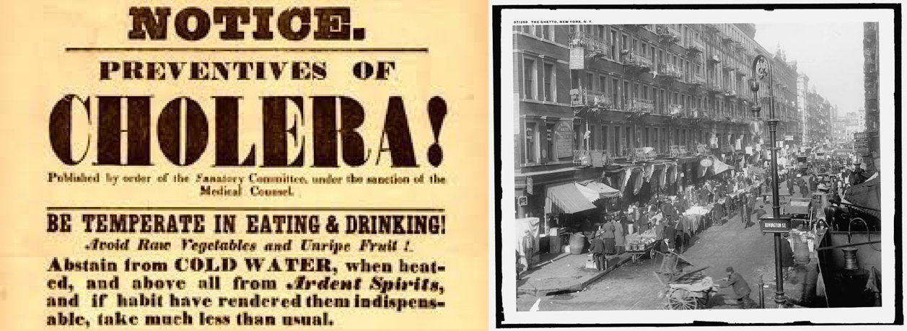
The 19th Century Cholera Pandemic revealed the overcrowding and poor infrastructure of growing cities,

Slide 5
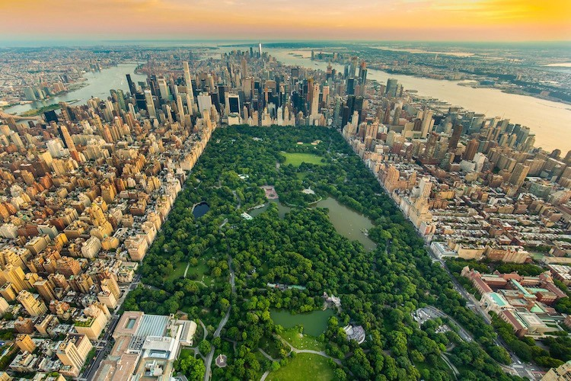
which led to the rise of public parks, water utilities, sanitary sewer systems, and indoor plumbing requirements.

Slide 6

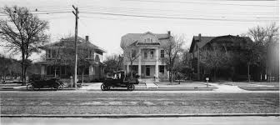
The 1918 Influenza Pandemic prompted a demand for social distancing, single-family housing, and private automobiles,

Slide 7
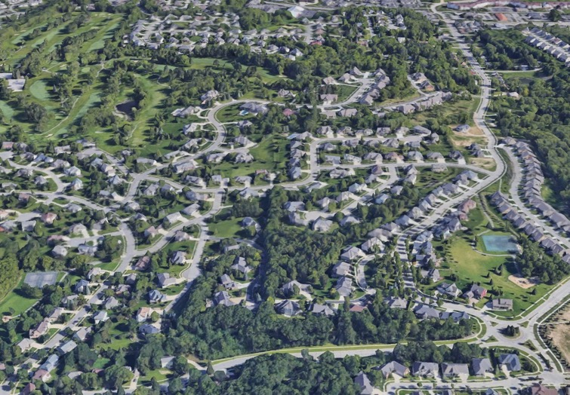
which led to a demand for single-use zoning, side-yard setbacks, and automobile-oriented infrastructure.

Slide 8
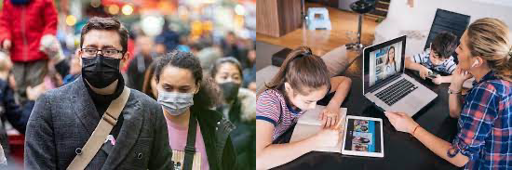
The COVID-19 Pandemic has reset the digital and physical worlds, revealed inequities, and elevated health as a key issue.

Slide 9
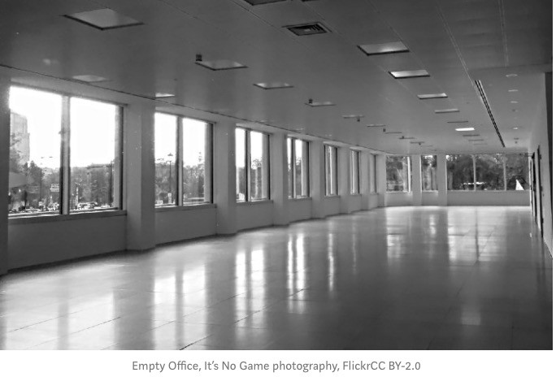
Post-Pandemic Offices

Slide 10
A disrupted office industry
42% of the workforce is now working from home full-time, accounting for 2/3rd of U.S. economic activity.
91% of the employers surveyed found that their staff is more productive working from home.
75% of employees working from home want to continue to do so at least one or more days a week, with 32% wanting to work fulltime from home even after the pandemic.

Slide 11
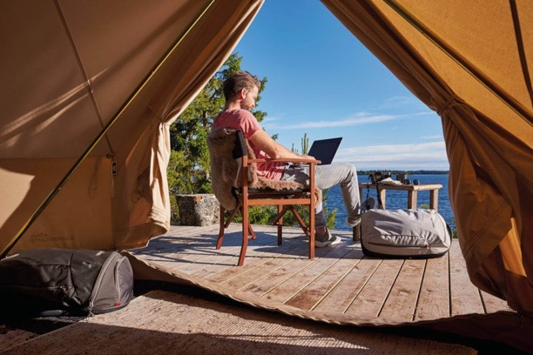
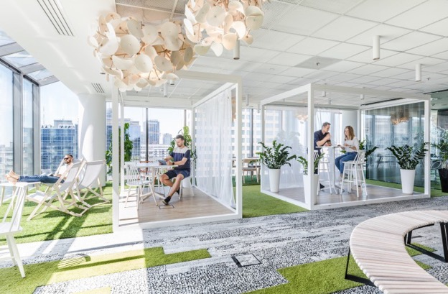
Remote work will become more common, occurring in places where there is a high quality of life and home-like environments.

Slide 12
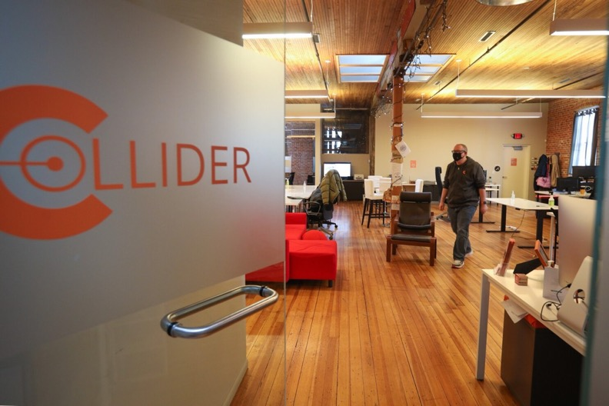
Co-working spaces may need to curate remote and in-person collaborations and provide services that don’t exist at home

Slide 13
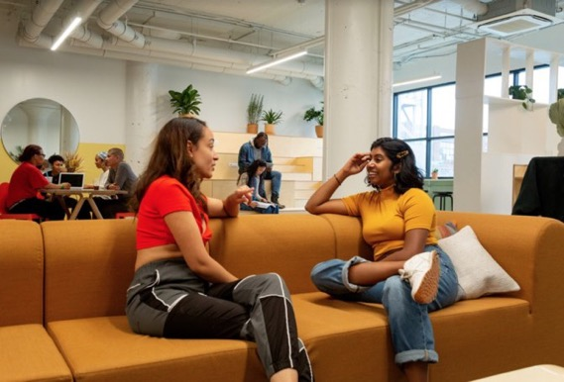
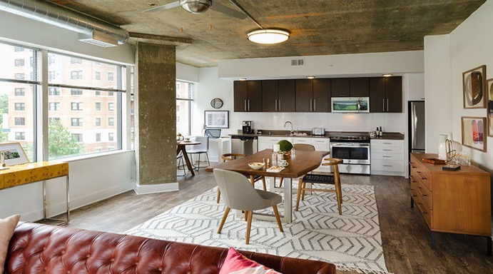

The office may need to enable live-work activities, possibly in the same building, with new kinds of housing options.

Slide 14
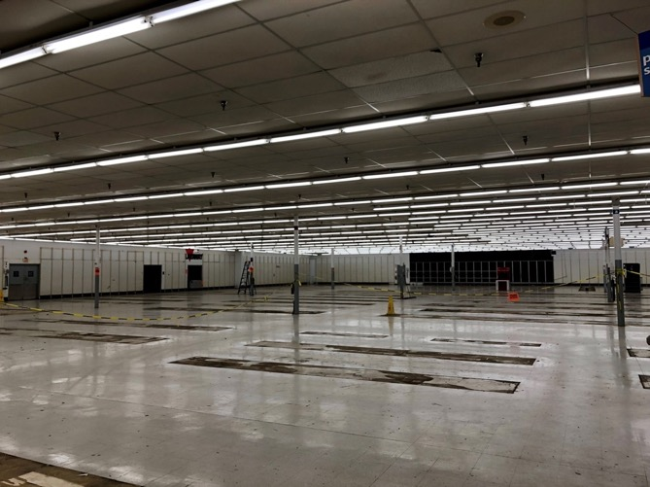
Post-Pandemic Retail

Slide 15
A disrupted retail industry
America has over 10 times the number of stores per capita than Germany and 5 times the number in the U.K., with store closures at an all-time high.
As many as 40% of small, locally owned businesses will not re-open after the pandemic, accelerating the trend toward national chains dominating the retail in cities.
Buying groceries online has almost doubled since the pandemic, with more than 50% of people surveyed planning on continuing to grocery shop online after the pandemic.

Slide 16

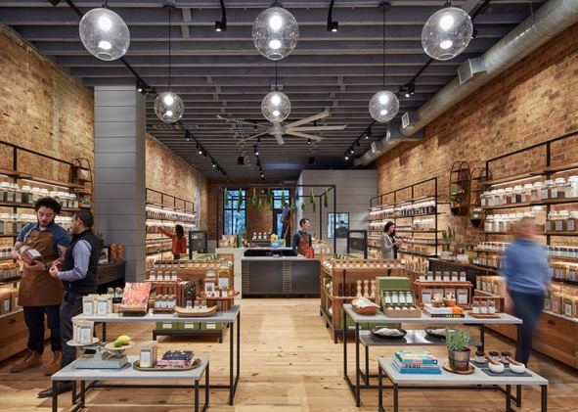
In-person retail may need to focus on what online shopping cannot offer, such as immersive, memorable experiences

Slide 17
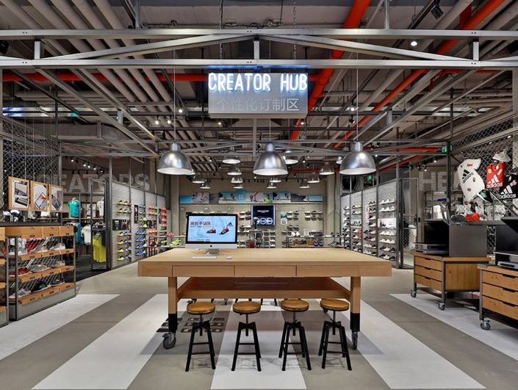
Bricks-and-mortar stores may need to see customers as co-creators in helping make better products and services.

Slide 18
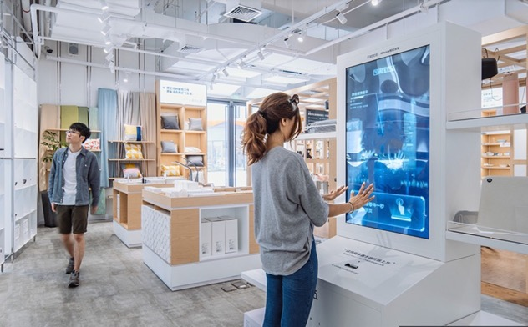
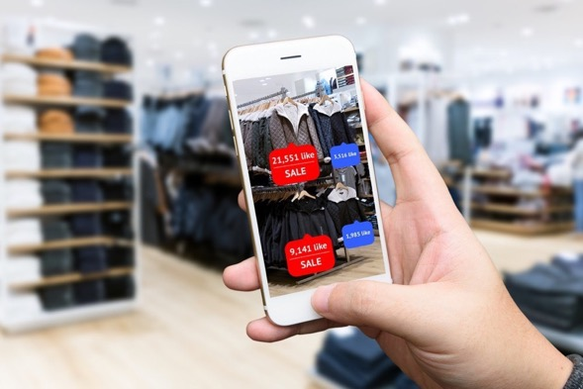
The interaction of the digital and physical world may take various forms, with each complementing the other in different ways.

Slide 19
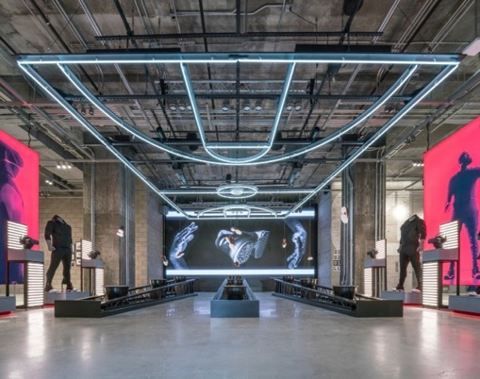
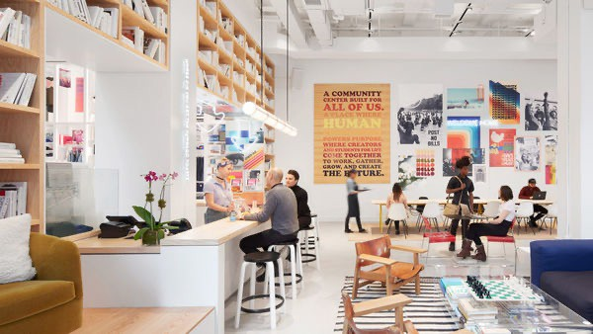
Retail may become more about community building, participatory entertainment, and serendipitous interactions.

Slide 20
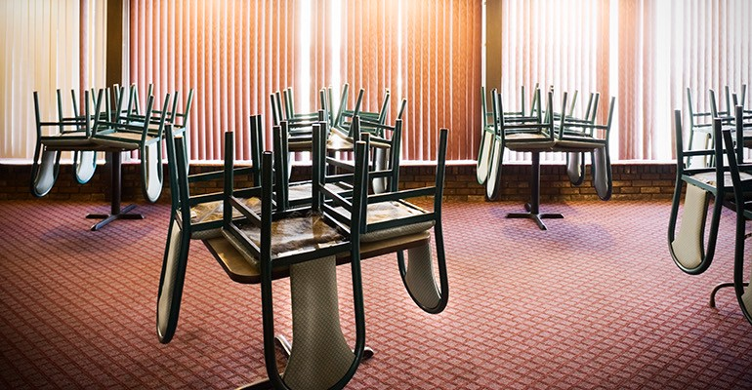
Post-Pandemic Restaurants

Slide 21
A disrupted hospitality industry
53% of restaurants are now listed as permanent closures, while one in four restaurants are at risk for closure.
The restaurant industry has already lost $120 billion and could lose as much as $240 billion by year’s end.
52% of Americans would feel uncomfortable dining in a restaurant/bar even after they reopen

Slide 22
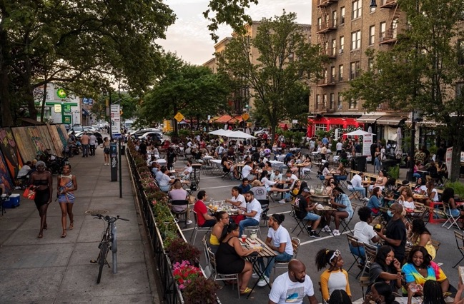
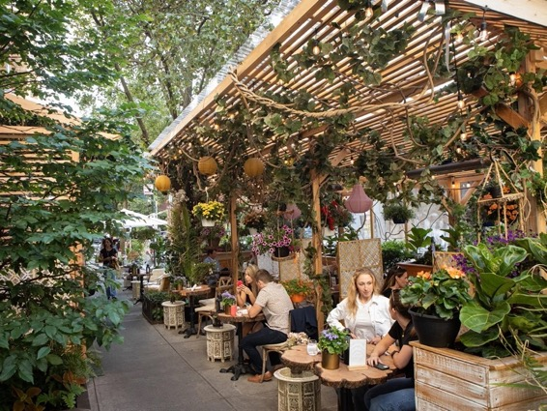
Dining may become a more public activity, appropriating public space and making it an integral part of the city.

Slide 23

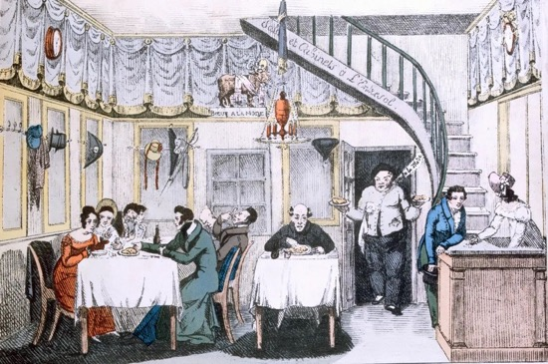
Indoor dining may need to rediscover its origins as a place to go in order to be “restored,” with curated experiences.

Slide 24
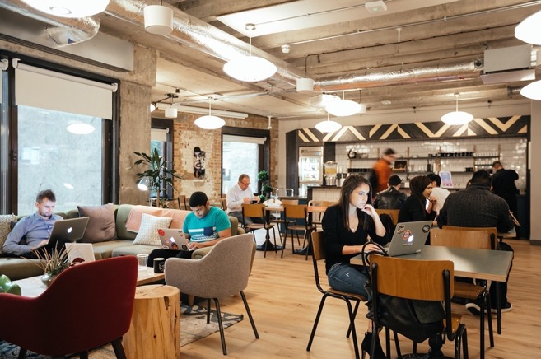
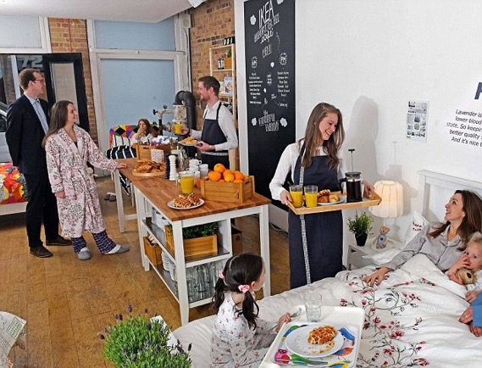
And dining may become hybridized with other types of services, where food becomes a part of production and consumption.

Slide 25
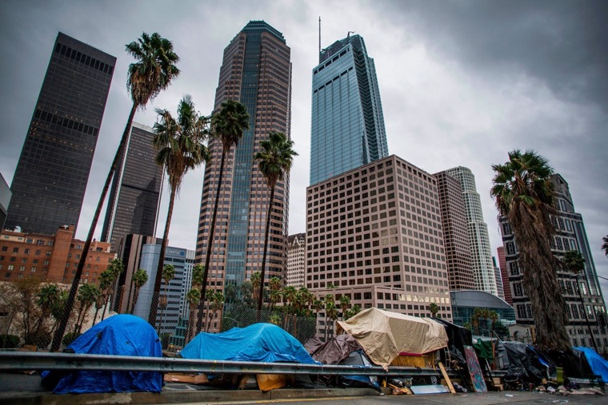
Post-Pandemic Housing

Slide 26
A disrupted housing industry
60% of renters have lost income and the moratorium on evictions for 12 million units of housing has ended.
Half a million Americans are now homeless, and that is expected to grow to 2 million across the U.S.
7.2 million more affordable housing units are needed for extremely low- income families in the U.S.

Slide 27
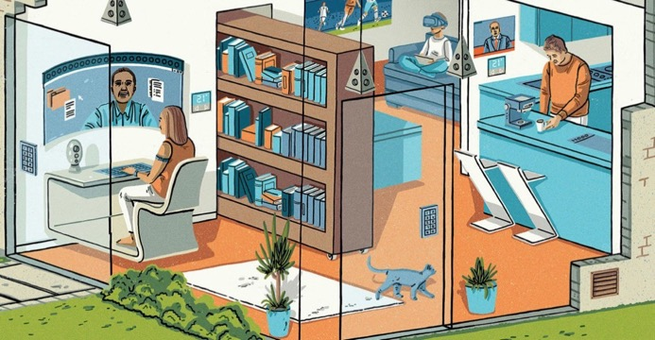
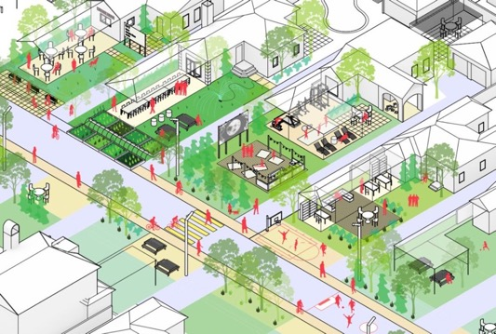
The interiors of homes will likely change as telecommuting, online shopping, distance learning, and the sharing economy become widespread.

Slide 28
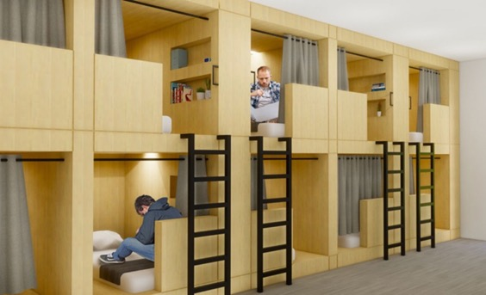
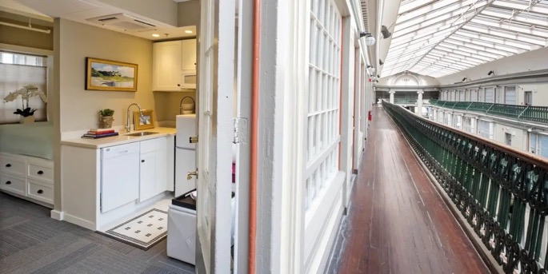
Housing will increasingly occupy vacant spaces intended for other purposes, greatly reducing costs and serving people unstably housed.

Slide 29
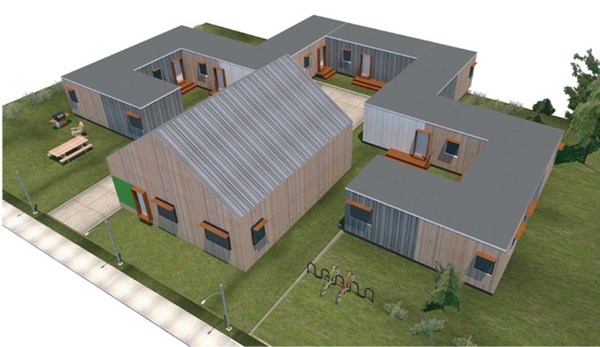
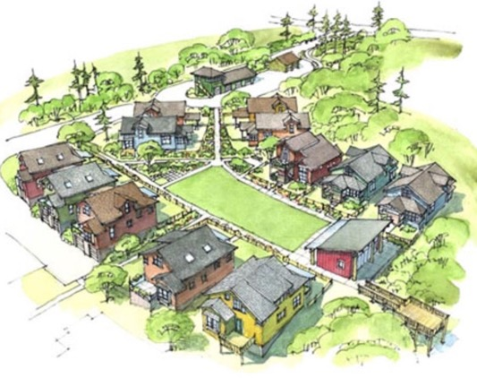
Housing may also become more community focused, with shared facilities, smaller footprints, and common spaces.

Slide 30
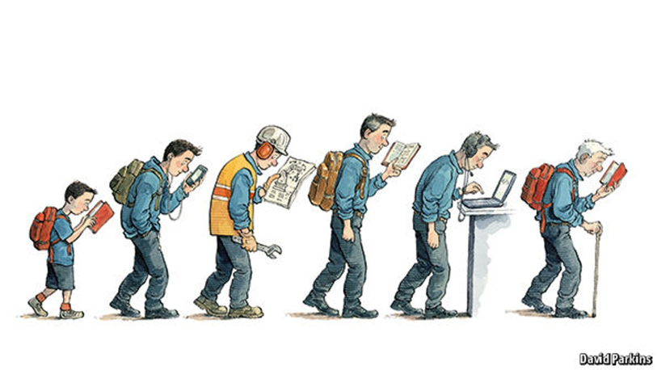
Post-Pandemic Higher Education

Slide 31
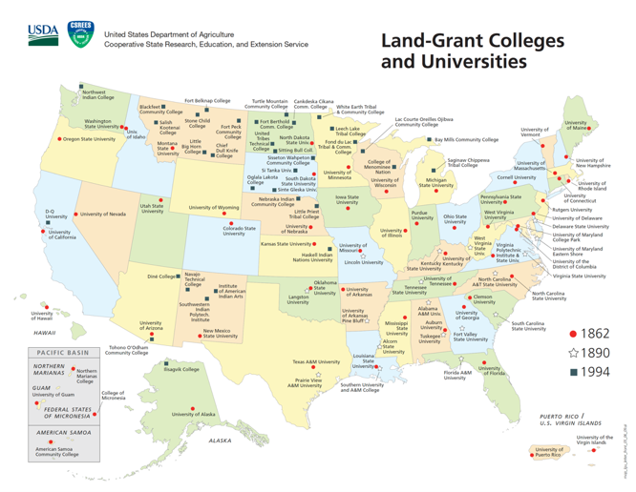
The mid-19th Century cholera pandemic caused by poor infrastructure led to the rise of land-grant universities to teach the “mechanical arts.”

Slide 32
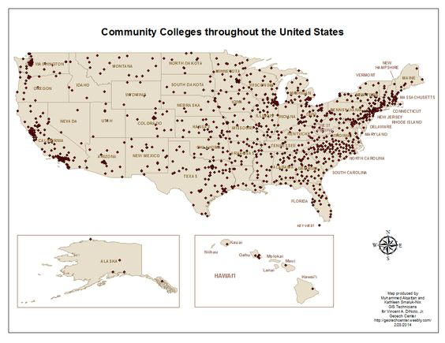

The 1918-20 Flu pandemic’s social distancing led to the AACC to form in 1920, in part so that students could study closer to home.

Slide 33
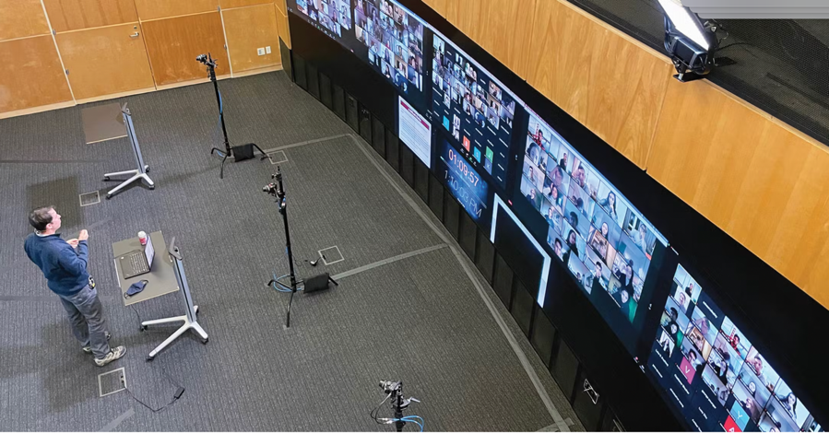
Higher education may be forced to become more accessible and affordable, redefining who is a student.

Slide 34
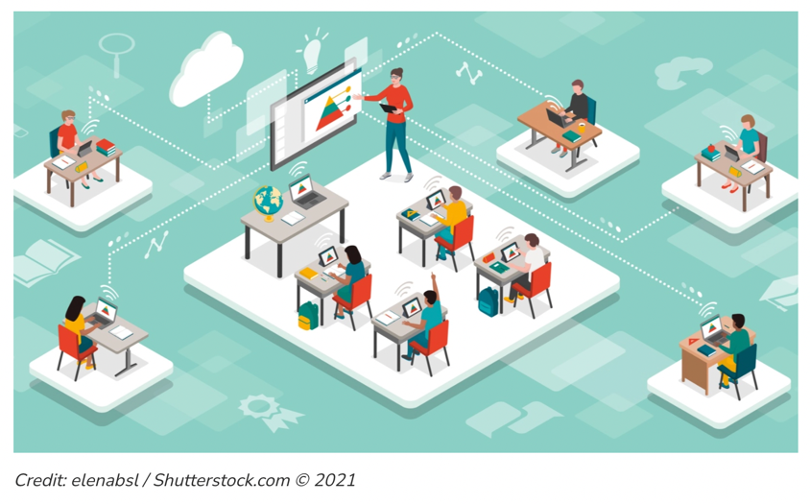
Campuses may need to change as hybrid education becomes the norm and as professors can teach and students learn anywhere in the world

Slide 35
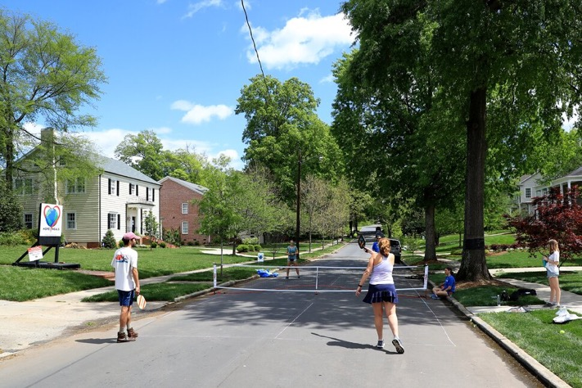
Streets and public works

Slide 36
A changing transportation system
Overall transportation use was down 58% compared to 2019, with commuter rail in cities like New York down 95%.
Transit use went down 58% in 2020 compared to 2019, and almost half of the experts seeing only a 50 to 65% recovery.
40% of experts see teleworking at least three days/week increasing by over 30%, and 45% seeing online shopping increasing by over 30%.
A increase of just 10-15% in teleworking could end rush-hours.

Slide 37
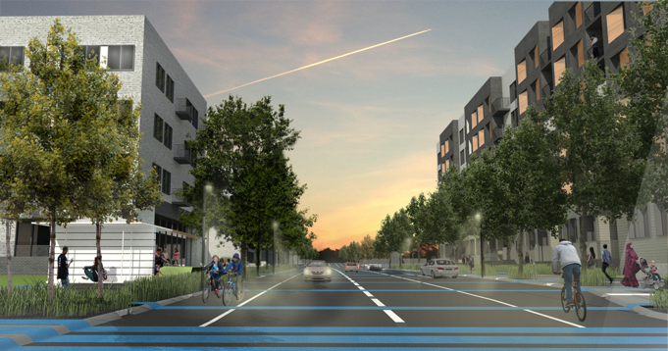
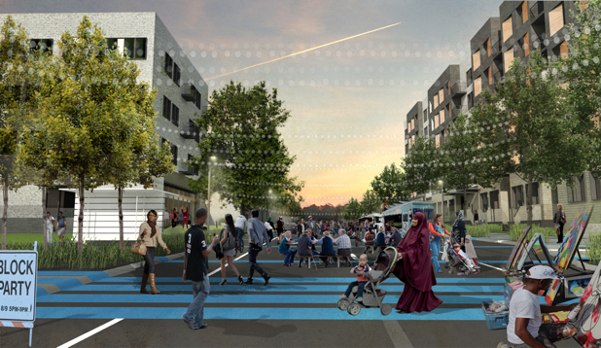
Streets may need to accommodate multiple uses over different times of the day or week
O2, Landscape Architects
Snow Kreilich Architects

Slide 38
With the coming of mobility services, parking may become less important than curb space or other development
Notes:
Autonomous vehicle technology already on the road. Evolved from aerospace industry. 100 years ago took an animal – horse – out of our transportation system because cars were cheaper, cleaner, and safer. Today, taking another animal – us – out of the system because AV cheaper (1/3 to ¼ cost per mile), cleaner (electric powered), and safer (saving most of the over 30,000 deaths and 100s of thousands of injuries annually). As part of car sharing services, becomes efficient, inexpensive, and pervasive taxi service with annual contracts

Slide 39
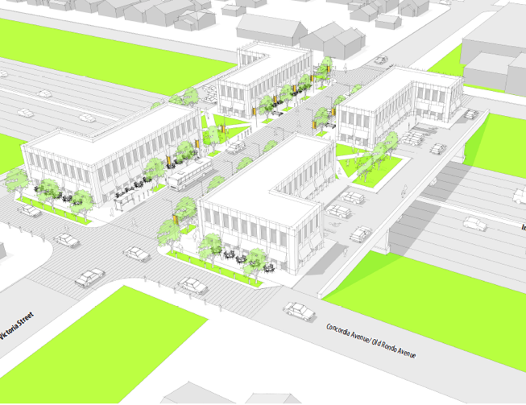
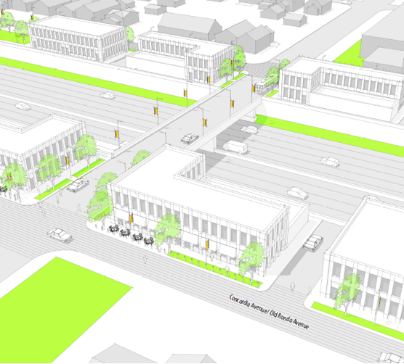
With changing transportation demand, highway air-rights may be increasingly used for other development

Slide 40
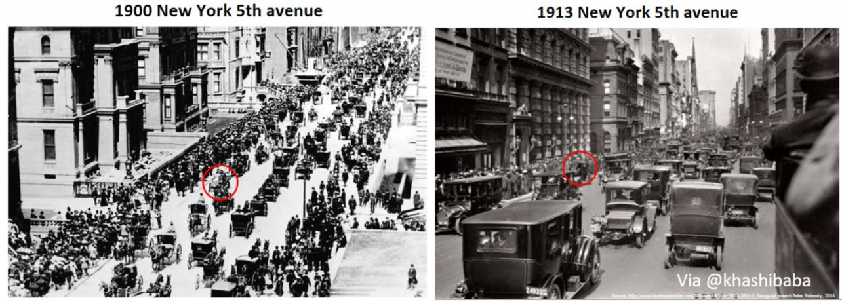
We should not be complacent and think that change will happen slowly and over a long period of time?

Slide 41
The questions we will need to ask of all development from now on:
What can the physical world offer in terms of experience that the online world cannot and what does the “phygital” world look like?
What value does in-person interaction have compared to remaining remote and how do we deal with permanent hybridity?
How can we creatively reimagine purpose-built space that needs to adapt to new uses without tearing it all down?
How can we have more flexible regulations to allow the market to respond to changing needs without favoritism or unfairness?
How can we reduce inequalities and negative impacts on the climate in the process of doing all of the above?

