Slide 1
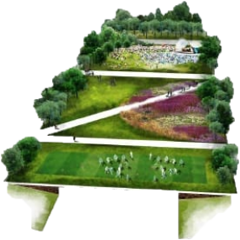
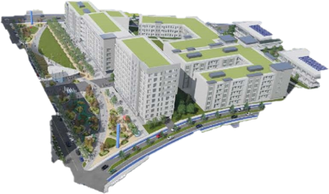
Covering Highways, Transforming City Neighborhoods
Minnesota Chapter of Land Economics Society
Luncheon 2.12.2020

Slide 2
Presenters
Cyrus Knutson
Center for Community Connections
MnDOT
Keith Baker
Managing Director
ReConnect Rondo
Michael A. Fischer
LHB Corp &
Edina City Council

Slide 3
Overview of Today’s Conversation
Cyrus Knutson: Brief overview of lid usage in the U.S. and locally.
Keith Baker: ReConnectRondo’s work and discussion of proposed community model for lid development.
Michael Fischer: Offer lessons learned from the extensive planning and research done for Grandview Green lid concept.

Slide 4
What is a Lid?
Cap
Cover
Deck
Land Bridge
Lid

Slide 5
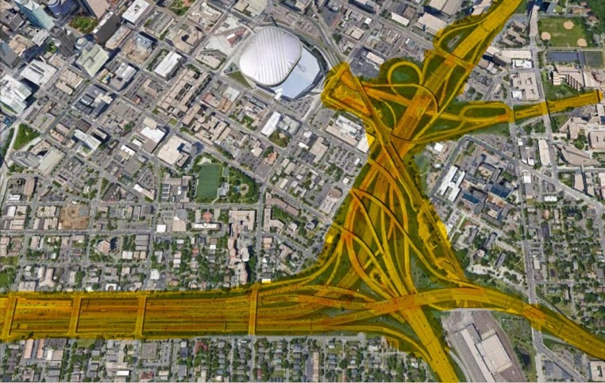
The Condition
I-94/I-35W – Minneapolis

Slide 6
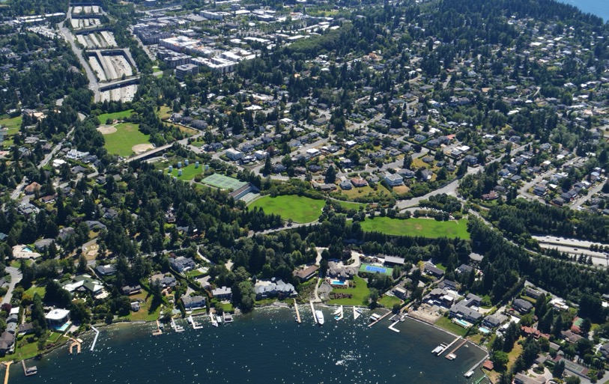
Early Response - Parks
Aubrey Park –Mercer Island, WA

Slide 7
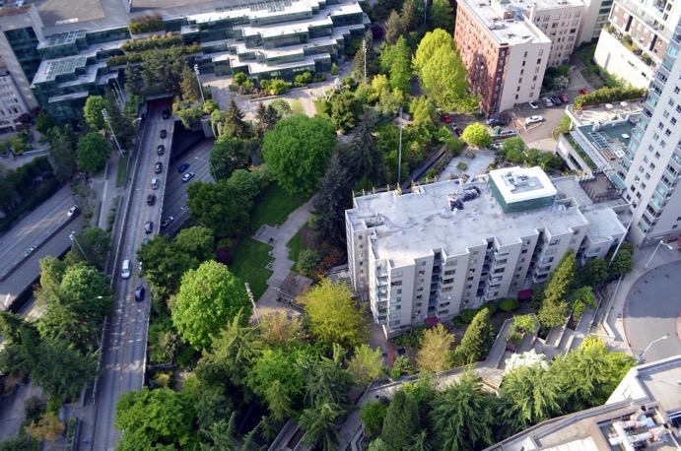
Early Response - Parks
Jim Ellis Freeway Park –
Seattle, WA

Slide 8
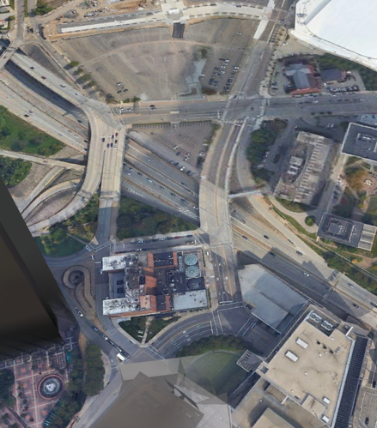
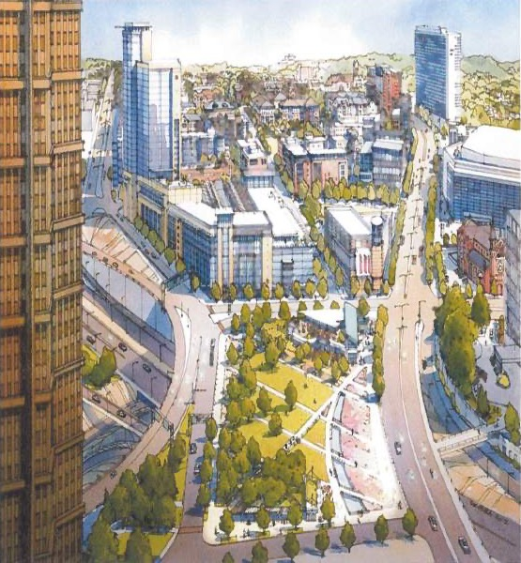
Recent Trend - Reconnection
Proposed I-579 cap – Pittsburgh, PA

Slide 9
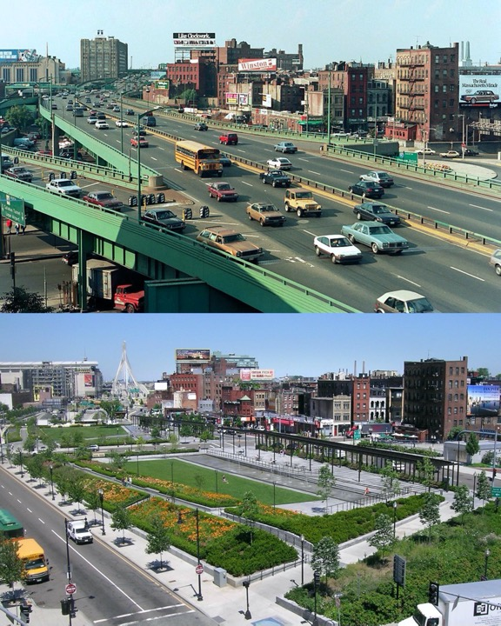
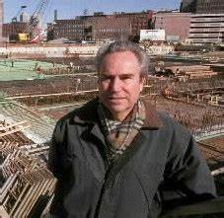
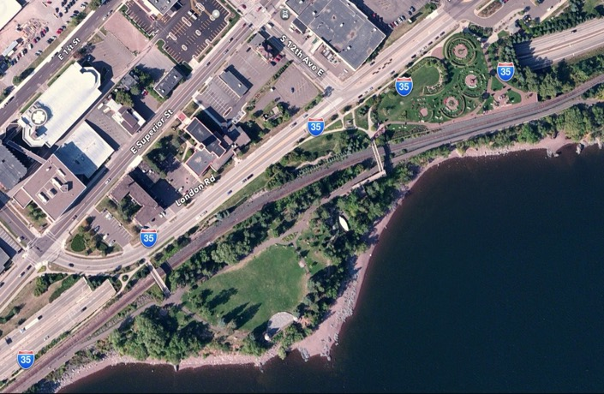
A Duluth Connection to “The Big Dig” in Boston

Slide 10
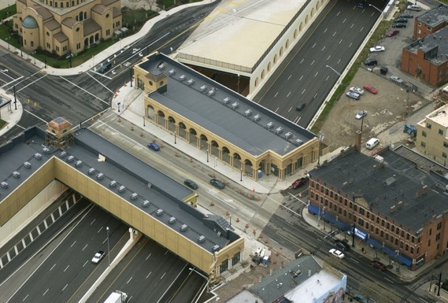
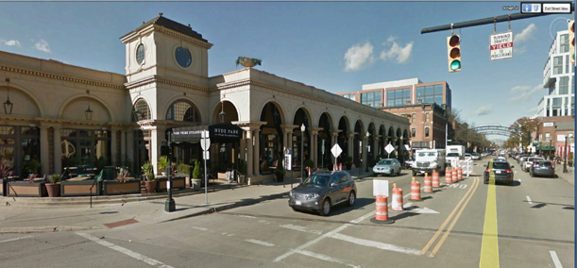
I-670 Cap at Union Station –
Columbus, OH
Land Economics & Development

Slide 11
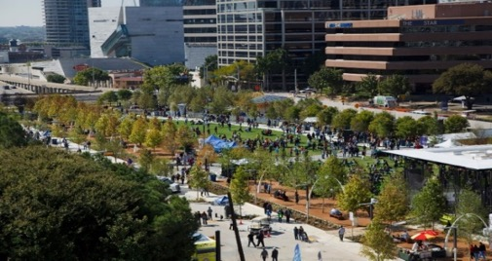
Catalyst for Development
Klyde Warren Park –
Dallas, TX

Slide 12
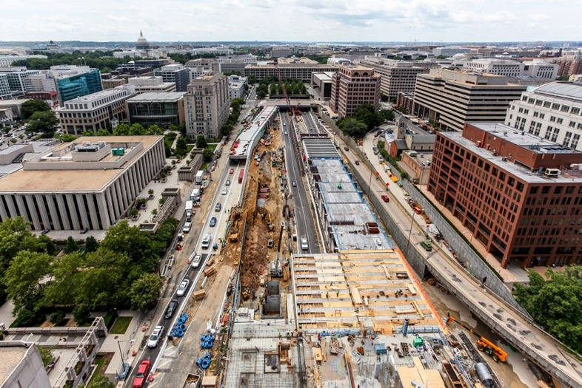
Airspace as Real Estate
Capitol Crossing –
Washington, D.C
(in progress)

Slide 13
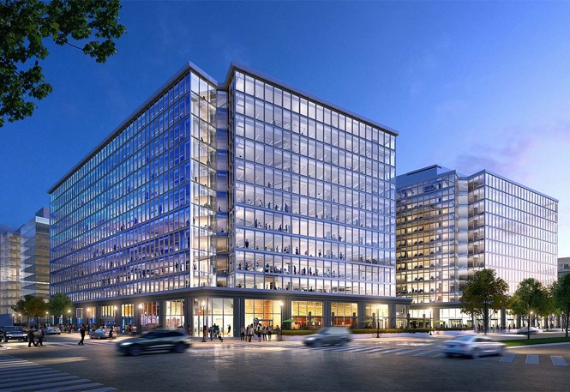
Airspace as Real Estate
Capitol Crossing –
Washington, D.C

Slide 14



Slide 15
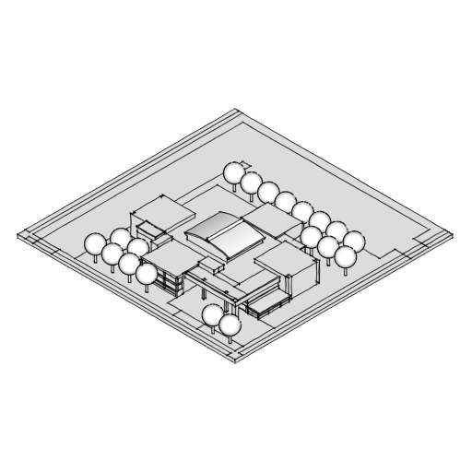
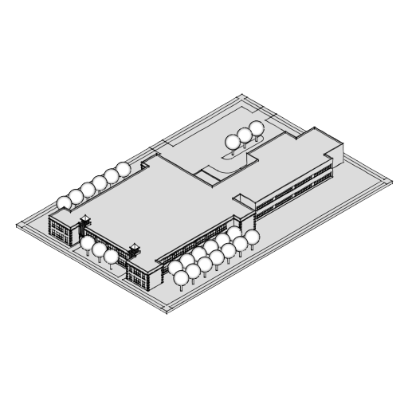
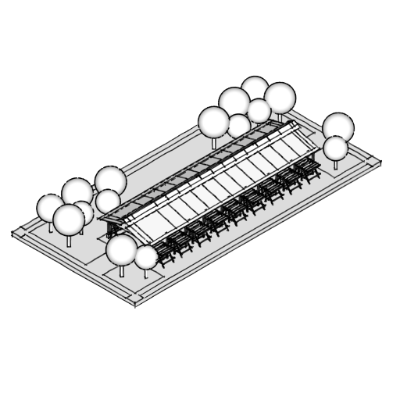
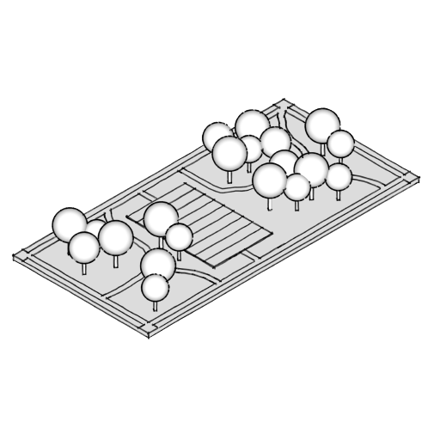
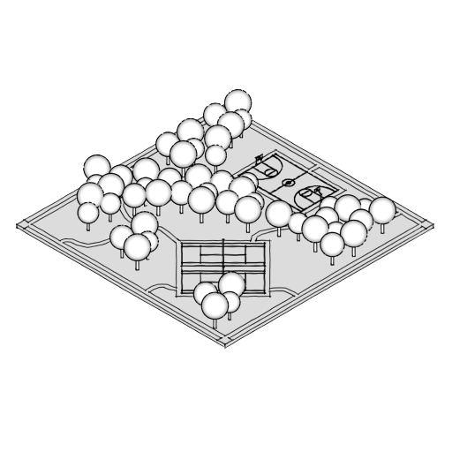
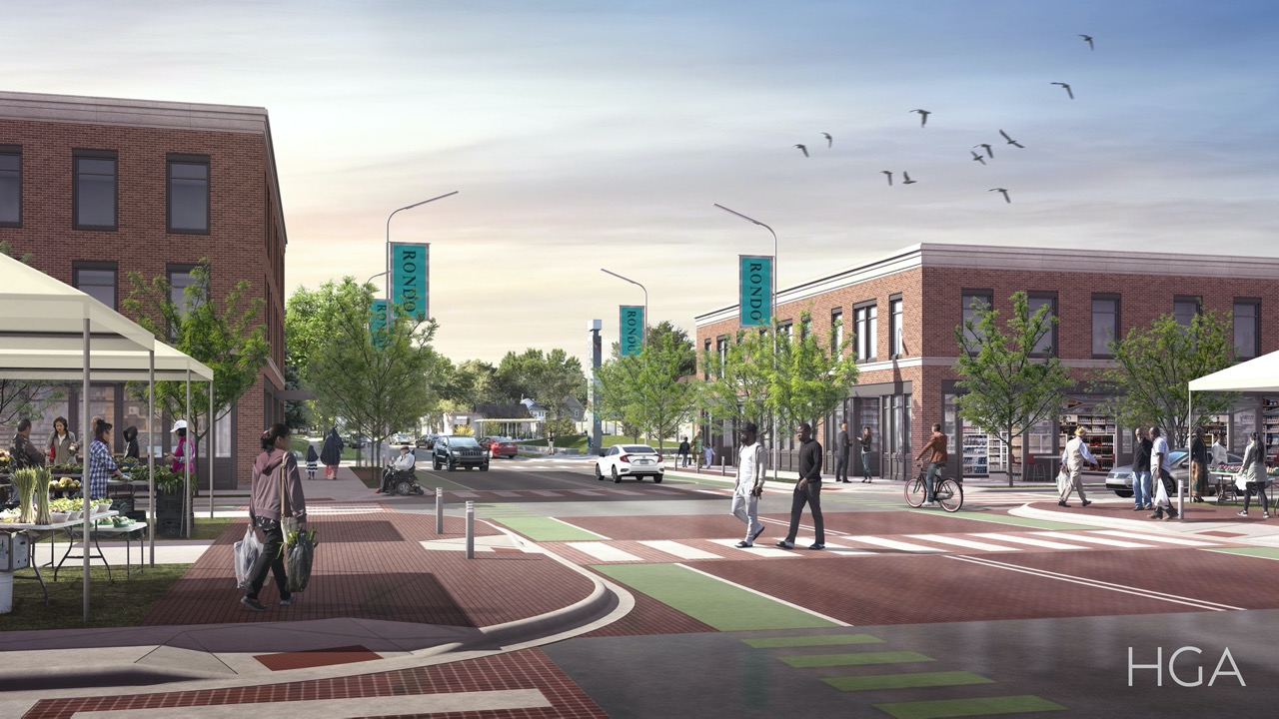
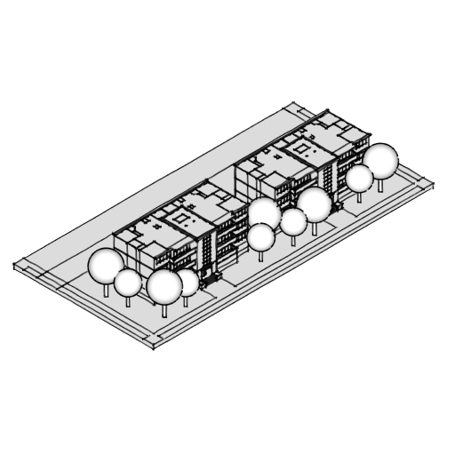
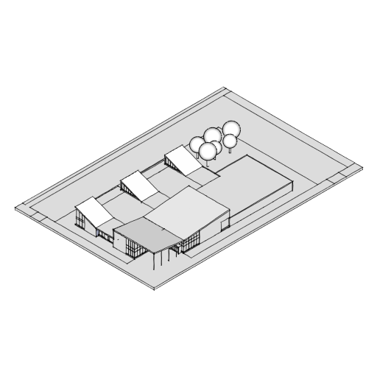
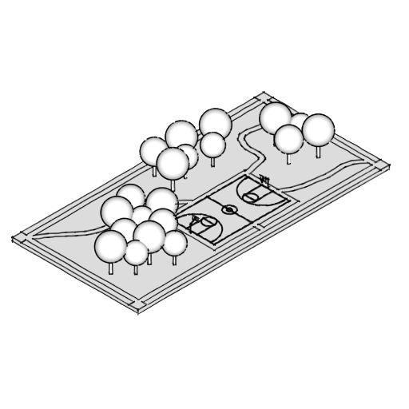
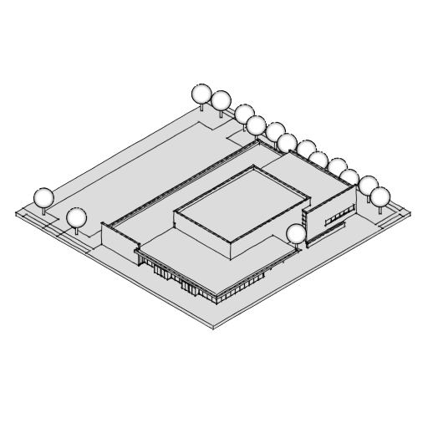
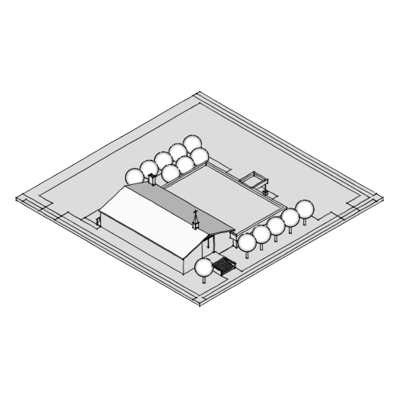
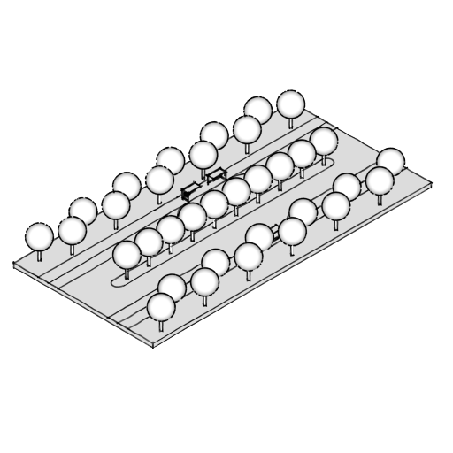
SINGLE FAMILY
LOOKING SOUTH ON FISK
Notes:
Looking south on Fisk

Slide 16
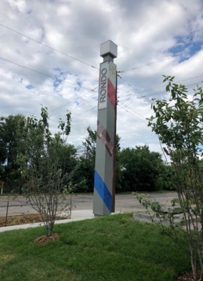
A Brief History
Mid 19th Century ex-slaves arrived at what is now the City of St. Paul
1956-67- Destruction of the community of Rondo
2009 Cap idea emerged regarding Rondo
2015 MnDOT and City Apologies
2016 MNDOT Healthy Communities - ULI Minnesota
2017 Developers Dialogue/Rondo Commemorative Plaza Opening
2018 RCR Awarded 5 day ULI ASP/4 L Community Report Out
2020 Feasibility Study final draft being completed

Slide 17
Desires & Outcomes
RESTORE
REVIVE
RECONNECT
Notes:
When development occurs who are the primary, secondary, and/or tertiary beneficiaries. Affordable Housing (Housing Affordability)

Slide 18
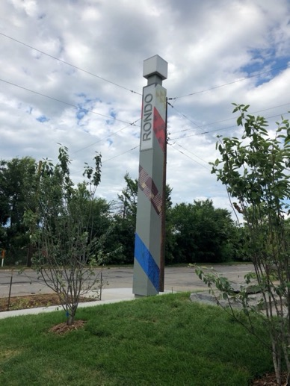
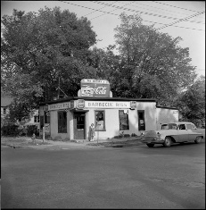
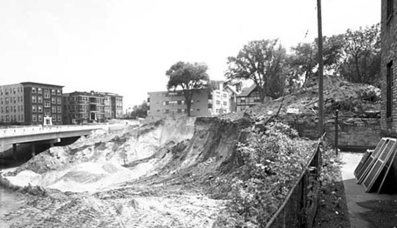
Reconnect Rondo Feasibility Study
Rondo Land Bridge Goals
  Neighborhood Reconnection
  Affordable Housing
  Equitable Development
  Public Health/Green Space
  Community Leadership

Slide 19

ULI Recommendations - 2018
Ensure inclusive, equitable development
African American leadership and ownership

Slide 20
Words & Definitions
Equitable Development
Affordable Housing – Housing Affordability
Communities (neighborhoods/residents)
Beneficiaries
Gentrification
Displacement

Slide 21
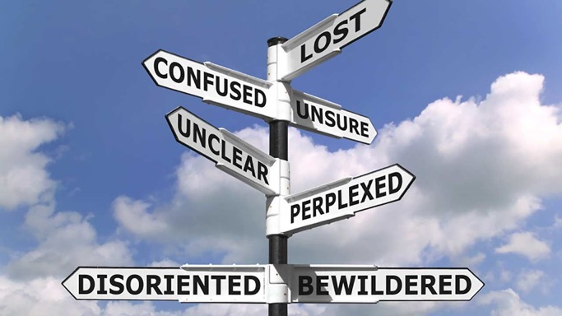
Notes:
Central Light Rail Project

Slide 22
Main Issue!
Communities feel done to
  Asked to participate – but it is managed participation.
  Asked for feedback – about what they don’t have a clue about
  Asked to forget – past projects where they saw little direct benefit
  Often feel on the back end of the process
  Rarely feel the direct benefits

Slide 23
Sub-Topics
Rondo Land Bridge (RLB) Stakeholder Ecosystem
RLB Community Task Force Topic Areas
RLB Agency Partners
(Statement of Partnership Support)
RLB Advisory Board
(Viable Path/Project)
Topic 1
Housing
Topic 2
Development
Topic 3
Health
Topic 4
History, Cultural & Arts Area
Topic 5/6
Education & Programs
Topic 7
Transportation & Mobility
C-Executive Fund Development Campaign
City of St. Paul
MnDOT/FHWA
Metropolitan Council
Ramsey County
Jobs & Workforce Pathways
Gentrification
Affordability
Displacement
Business Opportunities & Development
Green & Open Spaces
Urban Farming
Youth
Seniors
Families
Transit
Bicycles
Pedestrian
Wealth Building
Social Determinants of Healthy Communities
Sustainability
Ecological Economy
Equitable Development
Legal Land Use
Viable Project
Technical Guidance & Expertise
Museum, Visitor Center & Tours
Cultural Study & Historic Boundries
Art & Entertainment
Notes:
Our approach is a restorative one. One that is based on community building. But before we can get there we will need to understand the stakeholder ecosystem – and to leverage what currently exists that is responding to a variety of challenges that face communities independent of development brings – Displacement, Affordability, Negative Gentrification. “more than a bridge”

Slide 24
Who Leads Matters – Policy & Systems Driven
Policy Alignment
Strategic & Administrative Positioning
Community Systems Mapping & Stakeholders Leveraging
Resident Voice & Buy-In
Notes:
The ULI Report had several recommendations for Reconnect Rondo – and noted specific opportunities that could result from this proposition
ensureCommunity Leadership
Create an economic engine for the African American Community

Slide 25
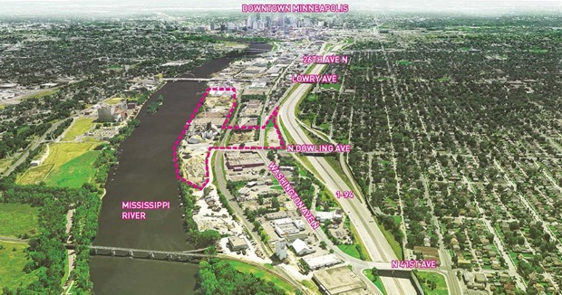
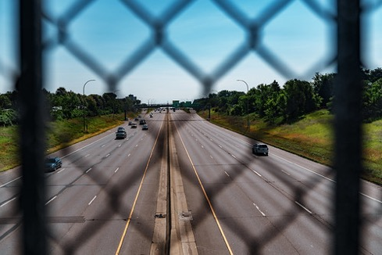
Traditional vs. Innovative Ways to View Development
Developer Public Asset
No Developer Public Asset

Slide 26
Community Limitations
An absence of understanding and experience with in-place systems, processes, tools and resources that benefit others who know them
And,
Imagination and definitions and readiness to leverage these elements to their own benefit

Slide 27
Equitable Development
An approach for meeting needs of underserved communities – considered an effective placed base action for creating strong and livable communities
Emphasis on participatory and inclusive processes and benefits
Notes:
When development occurs who are the primary, secondary, and/or tertiary beneficiaries. Affordable Housing (Housing Affordability)

Slide 28
Development Beneficiaries
Primary - developers
Secondary - communities
Tertiary - communities
Notes:
When development occurs who are the primary, secondary, and/or tertiary beneficiaries. Affordable Housing (Housing Affordability)

Slide 29
An Innovative Idea – RCR believes that community should be the primary beneficiary
Let the community hold the asset
Let the community be the developer
Let the community chose it’s partners to co-develop with
Notes:
When development occurs who are the primary, secondary, and/or tertiary beneficiaries. Affordable Housing (Housing Affordability)

Slide 30
An Innovative Idea – RCR believes that wealth building and ownership is key.
  A legally tested
    self-perpetuating, scalable and inclusive financing mechanism
    holds, manages, and leverages to the greatest extent possible assets
    maximizes systems, processes, tools and resources to ensure that residents, neighborhoods, and the community are primary beneficiaries.
Notes:
When development occurs who are the primary, secondary, and/or tertiary beneficiaries. Affordable Housing (Housing Affordability)

Slide 31
Who Leads Matters – Resident & Community Driven
Policy Alignment
Strategic & Administrative Positioning
Community Systems Mapping & Stakeholders Leveraging
Policy Alignment
Strategic & Administrative Positioning
Resident Voice & Buy-In
Community Systems Mapping & Stakeholders Leveraging
Resident Voice & Buy-In

Slide 33

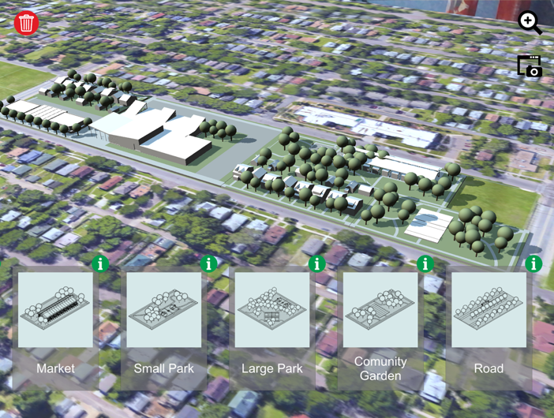

Slide 34
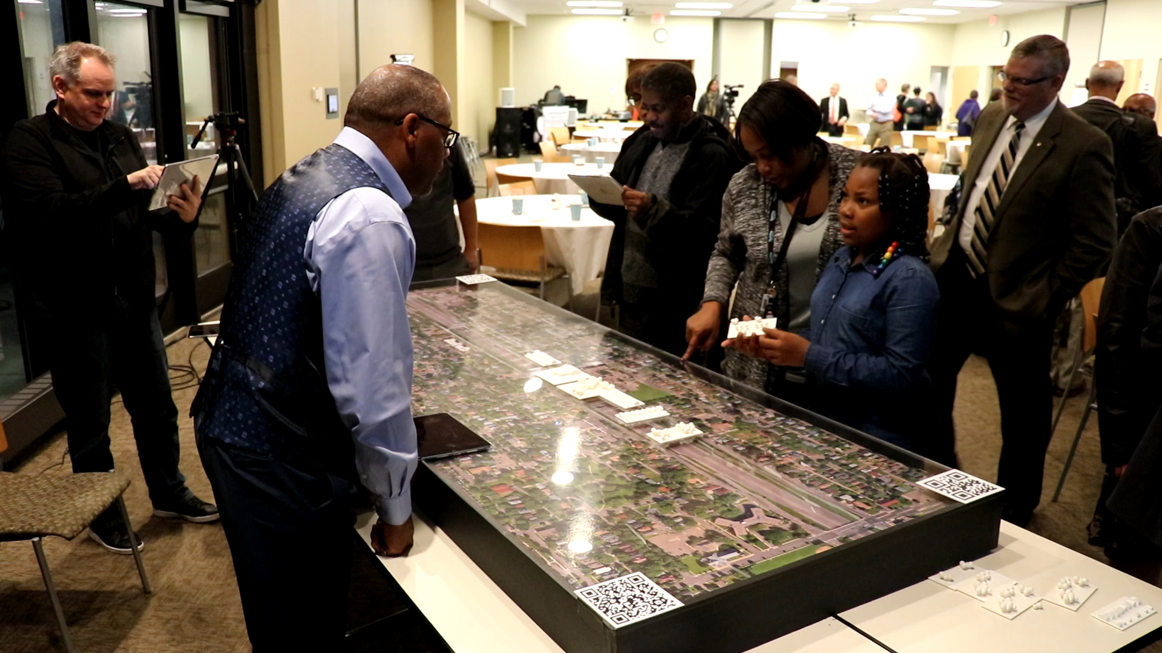

Slide 35
SINGLE FAMILY
LOOKING SOUTH ON FISK
Notes:
Looking south on Fisk

Slide 36
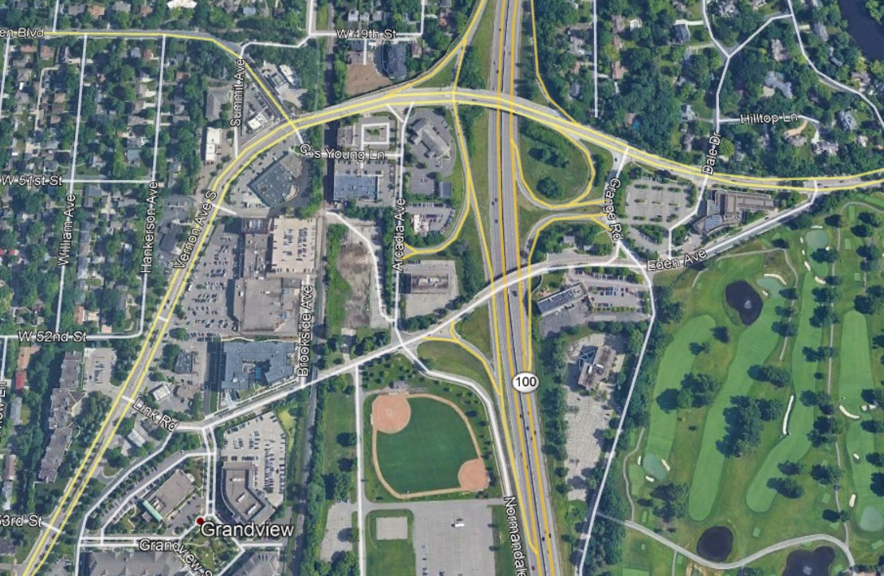
Lessons Learned in Edina

Slide 37
Grandview Planning Context
Dec 2008 Comprehensive Plan Identifies Grandview as a potential area of change
Dec 2009 Grandview Planning Process proposed
        10 Meetings in 20 Days
        Citizen Advisory Committee
        Volunteer Edina Resident Design Team
April 2010 Kick-off Meeting
        Business and Property Owner meetings
        Developer Roundtables
        Community Open House meetings
April 23/24 Design Workshop with Edina Architects

Slide 38
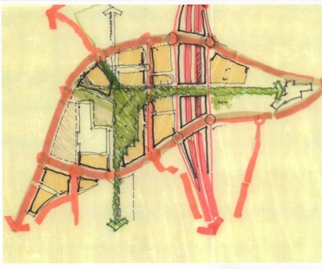
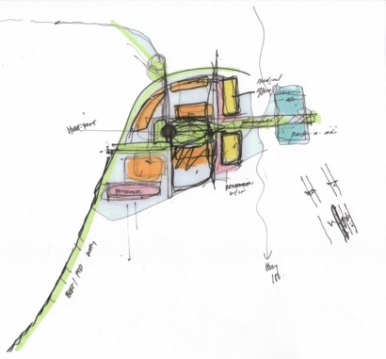
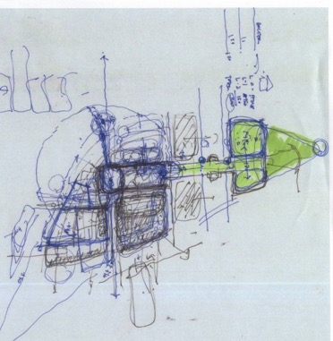
Design Workshop with Edina Architects

Slide 39
Grandview Planning Context
May 2010 City Council approves Guiding Principles
Nov 2010 Final Small Area Guide Plan Complete
April 2011 Staff applies for Met Council Grant
            $100,000 Livable Communities Grant
April 2011 Grandview District Framework Study Begins
            52 active community members on Steering Committee
April 2012 Grandview District Framework Complete

Slide 40
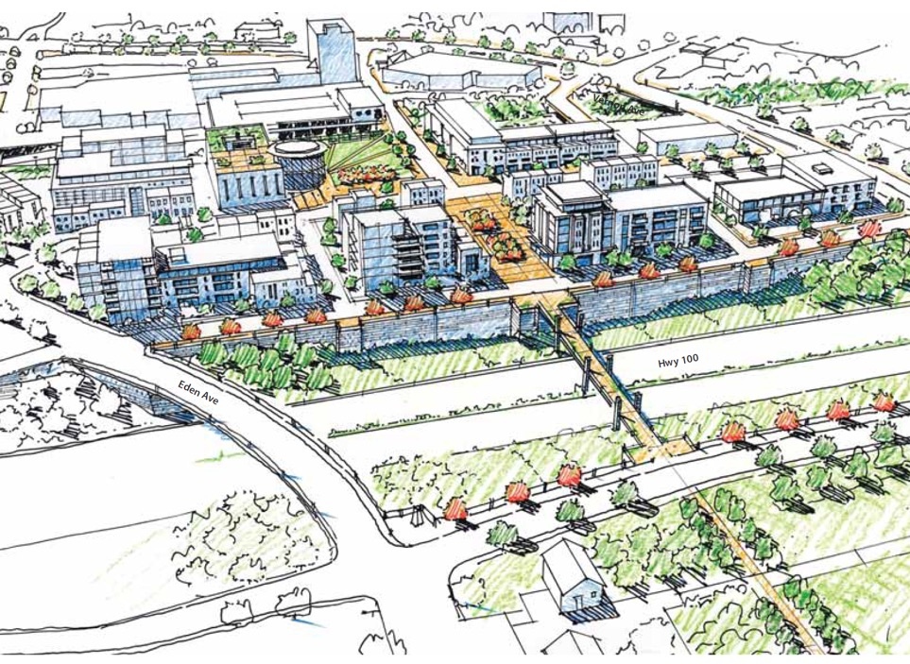
Grandview District Framework

Slide 41
Grandview Planning Context
April 2013 City Council Starts Focus on Public Works Site
            Selection of a Developer Partner
            Ongoing Design and Financial Studies
2015 MNDOT and UofM Design Center
            Proposal for a Lid Study
Nov 2015 Grandview District Transportation Study
Aug 2016 Grandview Transportation Study Complete

Slide 42
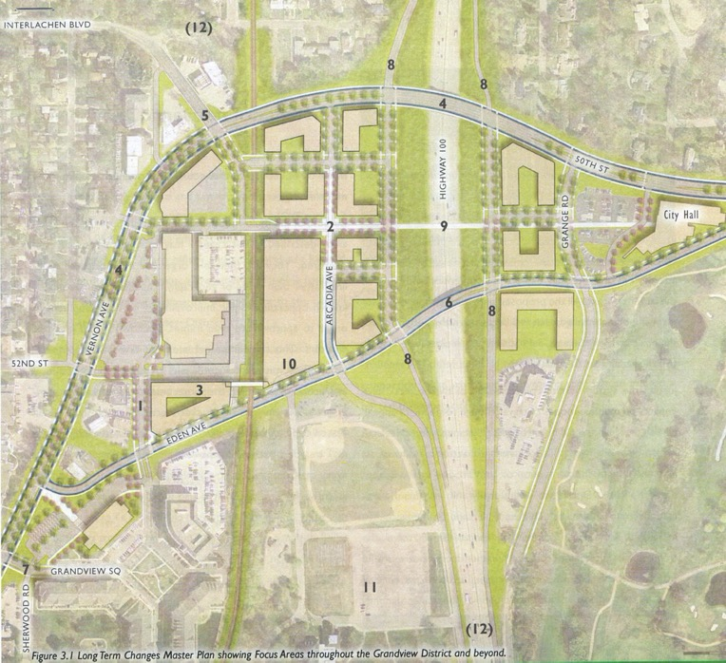
Short Term 0-5 Years
Medium Term 5-15 Years
Long Term 15-30 Years
Far Term Beyond 30

Slide 43
Far Term Changes
“Several significant elements would have to occur, perhaps simultaneously, in order for a lid to be realized including:
Realization of enhanced transit serving this district, including additional local and regional service related to Highway 100 (perhaps BRT), but also taking advantage of the existing rail corridor pursuing either light rail or modern streetcar options.”
Enhanced bicycle and pedestrian infrastructure was also a key consideration.

Slide 44
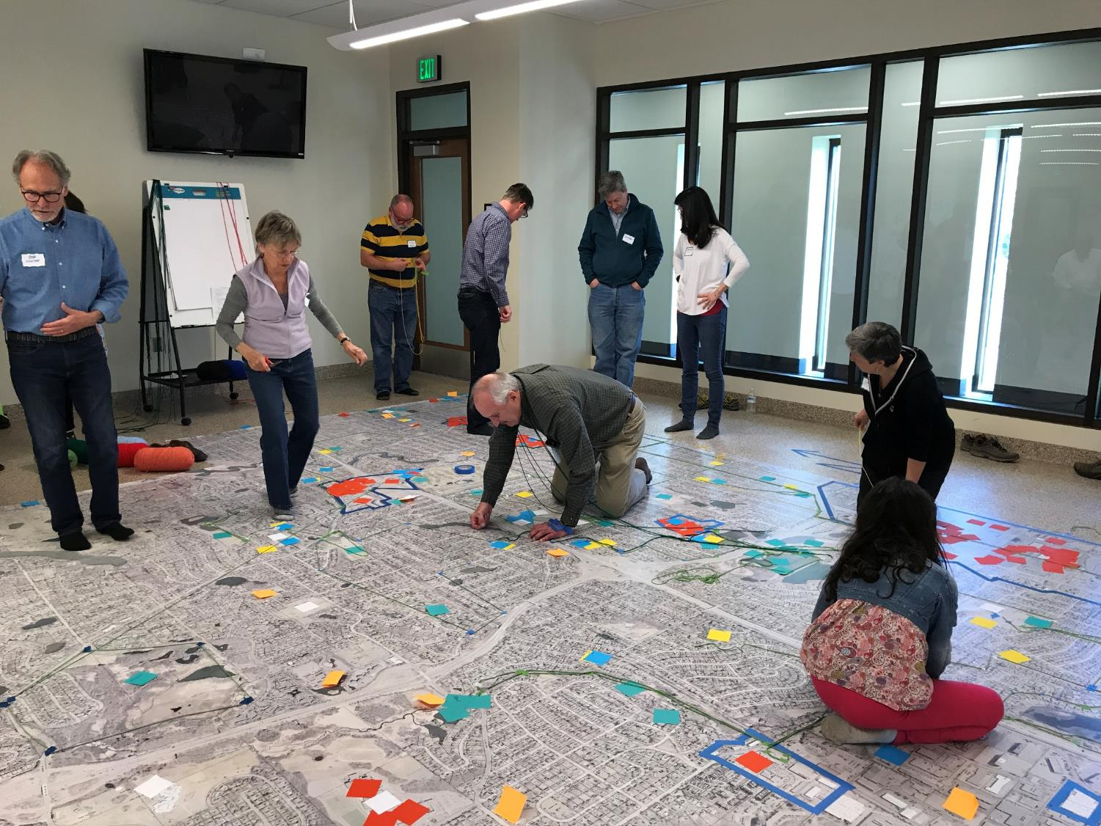

Slide 45
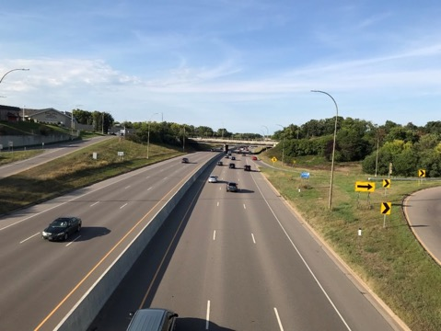
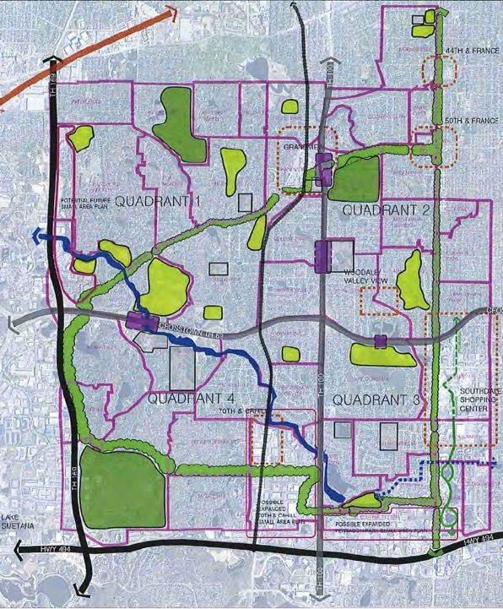
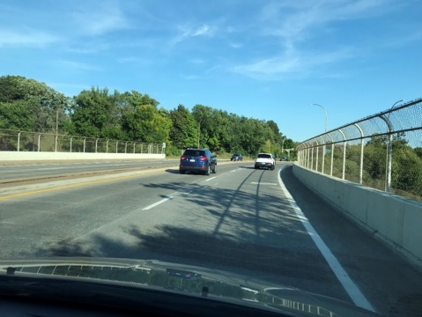

Slide 46
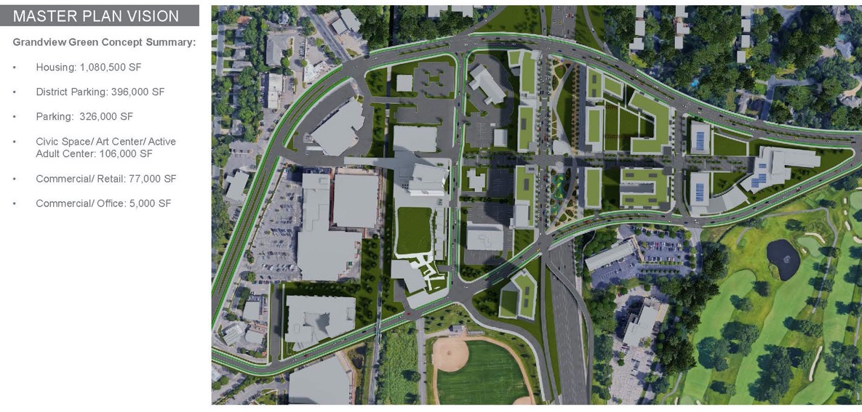

Slide 47
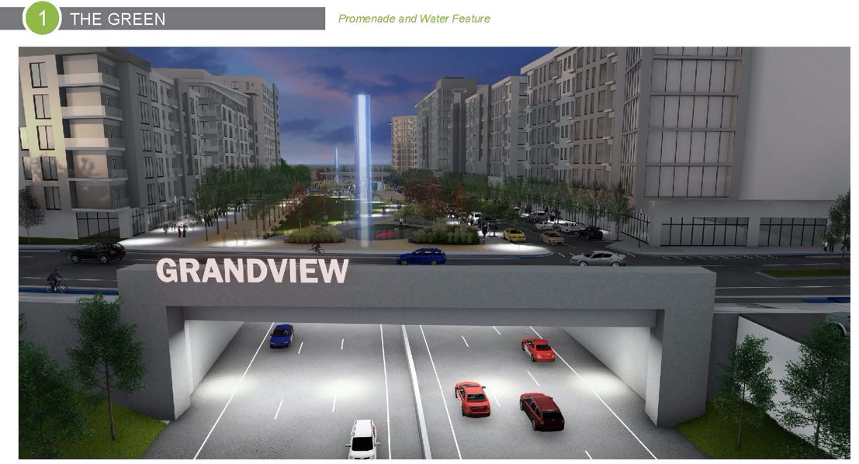

Slide 48
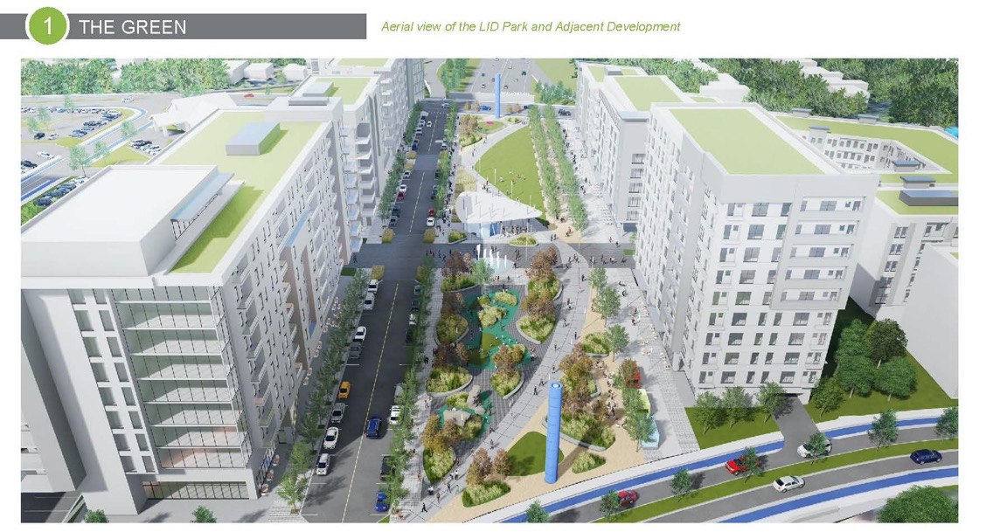

Slide 49
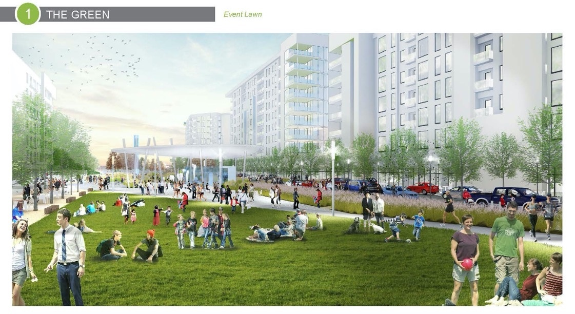

Slide 50


Slide 51


Slide 52


Slide 53
 | 2017 | 2018 | 2019 | 2020 | 2021
City Engagement
Public Agency Engagement
Community Engagement
Legislative Work
Funding and Financing
Concept Design/ Technical Studies
Development Master Planning
Detailed Design
Infrastructure Construction (Phased)
Building Construction (Phased)
Occupancy
Grandview Green
5-Year Vision
Infrastructure Construction Begins: 2020
Building Construction Begins: Mid-2020
Occupancy Begins: 2022
LEGEND
Explore
Discover
Build
Notes:
Hoping we are creating a roadmap that could be used in other communities across the metro, or potentially other parts of the state
Meetings with MnDOT every 2-3 weeks to identify areas of intersect such as shared property, air rights, ownership and maintenance

Slide 54

Lessons Learned in Edina

Slide 55

Lessons Learned in Edina

