Slide 1
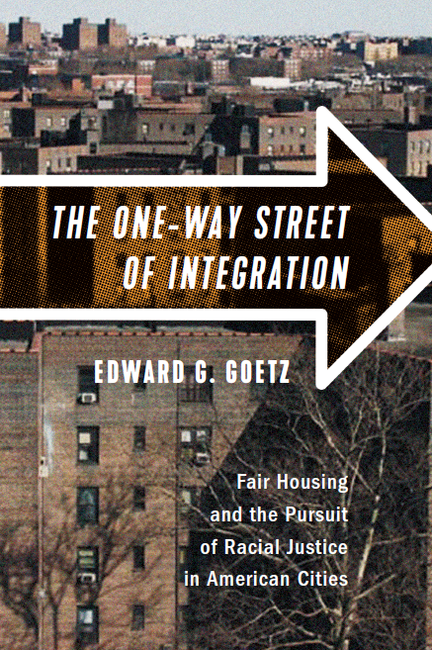
Presentation to
Lambda Alpha International
Minnesota Chapter
September 30, 2020

Slide 2
Otero v. nycha
Seward Park Urban Renewal Area, cleared 1967-72
Residents given priority for housing to be built on site
NYCHA reneges – “to fulfill the promise of priority would resegregate”
Former site residents sue and win
the duty to foster/maintain racial integration “could not as a matter of law be given effect where to do so would be to deprive a non-white minority of low-cost public housing that would otherwise be assigned to it.”

Slide 3
Otero v. nycha
NYCHA appeals
re-housing former site residents would create a “pocket ghetto” likely to trigger white flight and create a larger segregated community.
Court references Senator Mondale’s statement that Fair Housing Act “was designed to replace the ghettos ‘by truly integrated and balanced living patterns.’”

Slide 4
Otero v. nycha
NYCHA appeals
“The affirmative duty to … promote the policy of fair, integrated housing is not to be put aside whenever racial minorities are willing to accept segregated housing. The purpose of racial integration is to benefit the community as a whole, not just certain of its members.”
“To allow housing officials to make decisions having the long range effect of increasing or maintaining racially segregated housing patterns merely because minority groups will gain an immediate benefit would render such persons willing, and perhaps unwitting, partners in the trend toward ghettoization of our urban centers.”

Slide 5
Otero v. nycha
Enshrines ‘tipping point’ as guiding principle of housing allocation
Defines integration as the level of neighborhood diversity that whites will tolerate
Logic suggests people of color must be small minority within larger white community
Elevates integration above the equal access objective
Ratifies integration even when it imposes specific burdens on people of color

Slide 6
Integration as one-way street
Integration “based on complete acceptance of the fact that in order to have a decent house or education, black people must move into a white neighborhood or send their children to a white school. This reinforces, among both black and white, the idea that ‘white’ is automatically superior and ‘black’ is by definition inferior. For this reason, ‘integration’ is a subterfuge for the maintenance of white supremacy… Such situations will not change until black people become equal in a way that means something, and integration ceases to be a one-way street.”

Slide 7
Integration as one-way street
Integration “based on complete acceptance of the fact that in order to have a decent house or education, black people must move into a white neighborhood or send their children to a white school. This reinforces, among both black and white, the idea that ‘white’ is automatically superior and ‘black’ is by definition inferior. For this reason, ‘integration’ is a subterfuge for the maintenance of white supremacy… Such situations will not change until black people become equal in a way that means something, and integration ceases to be a one-way street.”
Stokely Carmichael, 1966

Slide 8
The “white proximity model”

Slide 9
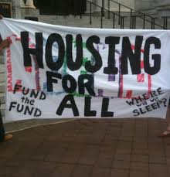
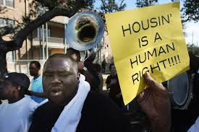
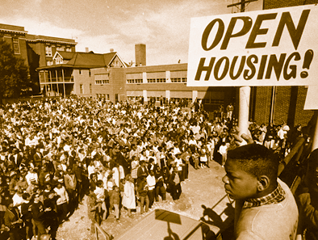
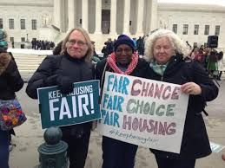
Affordable housing &
community development
advocates
Fair housing
advocates

Slide 10
Integration v. access
Dates to beginning of assisted housing

Slide 11
Integration v. access
Dates to beginning of assisted housing
“Such a choice – to oppose further public housing and to work instead for desegregation that would permit it to be scattered- is a hard one and most Negro leaders are not prepared to make it. Most hope that both ends can be served simultaneously, but if they cannot, then one must take what one can get.” James Q. Wilson, Negro Politics: The search for leadership. Glencoe, IL: The Free Press, 1960, page 188.
“If I had to make a choice, and I don’t always think you do, between more public housing or putting it in integrated areas, I would favor putting up more housing….There is a real need.” Black community leader, Ibid.

Slide 12
Integration v. access
Dates to beginning of assisted housing
Civil rights / Black power debate re: importance of preserving, enriching communities of color vs. integration

Slide 13
Integration v. access
Dates to beginning of assisted housing
Civil rights / Black power debate re: importance of preserving, enriching communities of color vs. integration
Malcolm X regarded integration as “a deception” – a kind of political sleight of hand that diverted attention from more fundamental questions of power. “…an uncritical acceptance of integration as either a method or an objective served only to reify white supremacy.”
Quotes from James Tyner, The Geography of Malcolm X: Black Radicalism and the Remaking of American Space, New York: Routledge, 2006, pages 79 and 87.

Slide 14
Integration v. access
Dates to beginning of assisted housing
Civil rights / Black power debate re: importance of preserving, enriching communities of color vs. integration
1970s housing-siting controversies

Slide 15
Integration v. access
Dates to beginning of assisted housing
Civil rights / Black power debate re: importance of preserving, enriching communities of color vs. integration
1970s housing-siting controversies
Shannon v. HUD, 1970
Gautreaux hearing, 1978

Slide 16
The 3 Stations of Fair Housing’s spatial strategy
1. “Open up” exclusionary communities

Slide 17
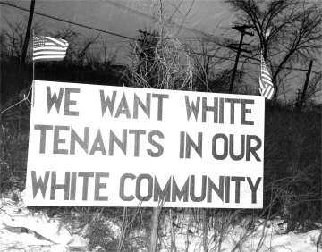
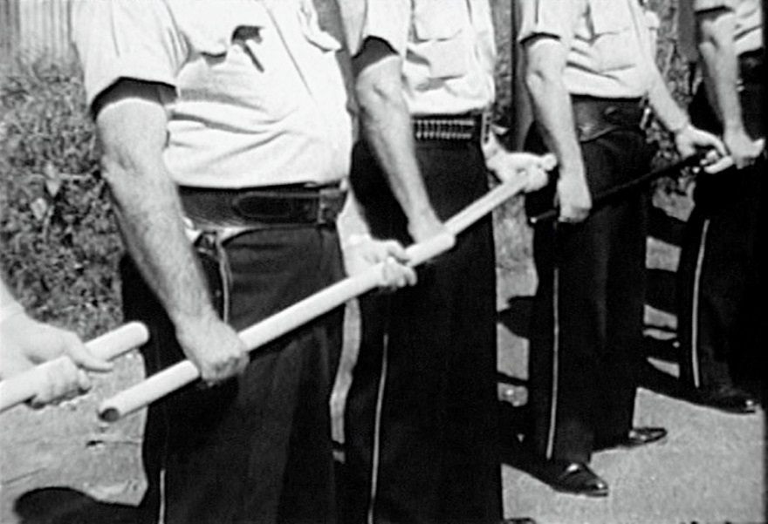
The 3 Stations of Fair Housing’s spatial strategy
1. “Open up” exclusionary communities
Discrimination, violence, & intimidation
Racially restrictive deeds and covenants
Exclusionary zoning

Slide 18
The 3 Stations of Fair Housing’s spatial strategy
1. “Open up” exclusionary communities
2. Prevent further ghetto formation

Slide 19
The 3 Stations of Fair Housing’s spatial strategy
1. “Open up” exclusionary communities
2. Prevent further ghetto formation
siting guidelines for assisted housing
“affirmatively further fair housing”
integration maintenance programs

Slide 20
The 3 Stations of Fair Housing’s spatial strategy
1. “Open up” exclusionary communities
2. Prevent further ghetto formation
3. Break up existing concentrations

Slide 21
The 3 Stations of Fair Housing’s spatial strategy
1. “Open up” exclusionary communities
2. Prevent further ghetto formation
3. Break up existing concentrations
HOPE VI & public housing demolition/ conversion
Desegregation lawsuits (Thompson, Walker, Hollman, Sanders, etc.)

Slide 22
The 3 Stations of Fair Housing’s spatial strategy
1. “Open up” exclusionary communities
2. Prevent further ghetto formation
3. Break up existing concentrations
HOPE VI & public housing demolition/ conversion
Desegregation lawsuits (Thompson, Walker, Hollman, Sanders, etc.)
Heritage Park on north side of Mpls

Slide 23
Contemporary manifestations
LIHTC legal action
In re adoption of 2003 Low Income Housing Tax Credit Allocation Plan, New Jersey
Inclusive Communities Project v. Texas Department of Housing and Community Affairs, Dallas
Minneapolis-Saint Paul complaints

Slide 24
Contemporary manifestations
LIHTC legal action
In re adoption of 2003 Low Income Housing Tax Credit Allocation Plan, New Jersey
Inclusive Communities Project v. Texas Department of Housing and Community Affairs, Dallas
Minneapolis-Saint Paul complaints
“Our case challenges the notion that more or new affordable housing in cities is fundamentally helpful for revitalization. In fact, building affordable housing in the cities has no net revitalizing effect at all.”
Staff attorney, New Jersey Fair Share Housing Center (in Neuwirth 2005)
Notes:
Add the contested nature of the QCT provision

Slide 25
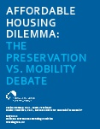
Contemporary manifestations
LIHTC legal action
In re adoption of 2003 Low Income Housing Tax Credit Allocation Plan, New Jersey
Inclusive Communities Project v. Texas Department of Housing and Community Affairs, Dallas
Minneapolis-Saint Paul complaints
NLIHC Report, 2012

Slide 26
Contemporary manifestations (cont.)
Supreme Court, 2015 (Texas DHCA v. ICP)

Slide 27
Contemporary manifestations (cont.)
Supreme Court, 2015 (Texas DHCA v. ICP)
Establishes “disparate impact” as actionable standard under the Fair Housing Act

Slide 28
Contemporary manifestations (cont.)
Supreme Court, 2015 (Texas DHCA v. ICP)
“difficult to say as a general matter that a decision to build low-income housing in a blighted inner-city neighborhood instead of a suburb is discriminatory...”

Slide 29
Contemporary manifestations (cont.)
Supreme Court, 2015 (Texas DHCA v. ICP)
Disparate impact liability does not mandate “the displacement of valid governmental policies… The FHA is not an instrument to force housing authorities to reorder their priorities.”

Slide 30
Contemporary manifestations (cont.)
Supreme Court, 2015 (Texas DHCA v. ICP)
“It would be paradoxical to construe the FHA to impose onerous costs on actors who encourage revitalizing dilapidated housing in our Nation’s cities merely because some other priority might seem preferable.”

Slide 31
Choice and Burden
Can we increase choice without placing the burden on members of protected classes?
choice to stay, the ability to leave
equal access (non-discrimination) to increase choice
open up exclusionary communities (Station 1)
The burdens of integration
contact theory
enforced minority status
relocation
forfeiture of community

Slide 32
“Policies that seek to end unjust racial inequality by pushing, or even nudging, blacks into residential integration or that make needed resources available only on condition that blacks are willing to integrate show a lack of respect for those they aim to assist.”
Tommie Shelby, Dark Ghettos, 2017.

